Slide 1


Slide 2


Slide 3


Opbject Oriented Programming
TOPIC: VISUALIZATION OF OPERATIONS ON TREE DATA STRUCTURES
3

Slide 4

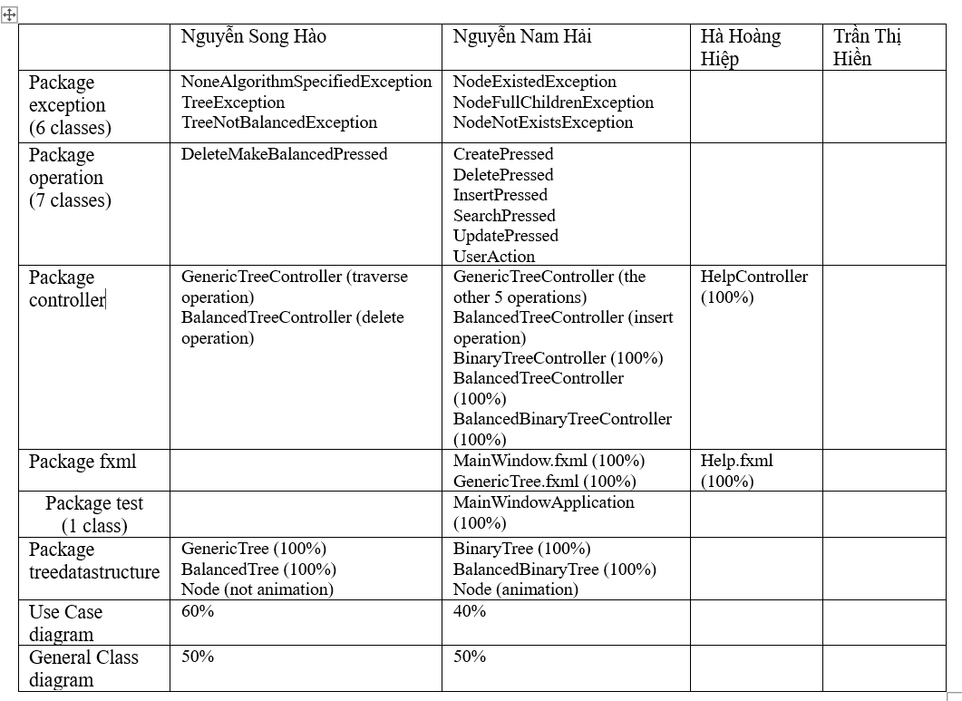
Task Assignment
4

Slide 5

Agenda
Introduction
Use Case Diagram
Project Design
General Class Diagram
Detail Class Diagram
Explanation of OOP techniques design
Demo
5

Slide 6
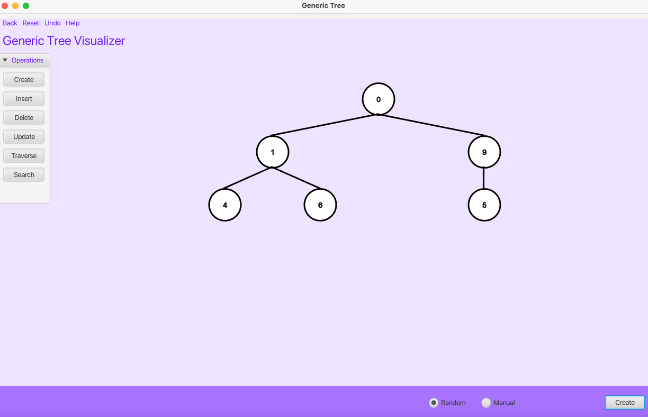
Introduction
The project aims to:
design a program that allows visualize and understand basic operations on different types of trees
the development of a user-friendly interface, clearly presenting and explaining basic tree operations, and ensuring interactivity and usability.
5

Slide 7
Introduction
The project includes:
4 types of trees: a generic tree, a binary tree, a balanced tree, and a balanced binary tree
6 operations: creating a new tree, inserting, deleting, updating nodes, searching for nodes, and traversing the tree
5

Slide 8

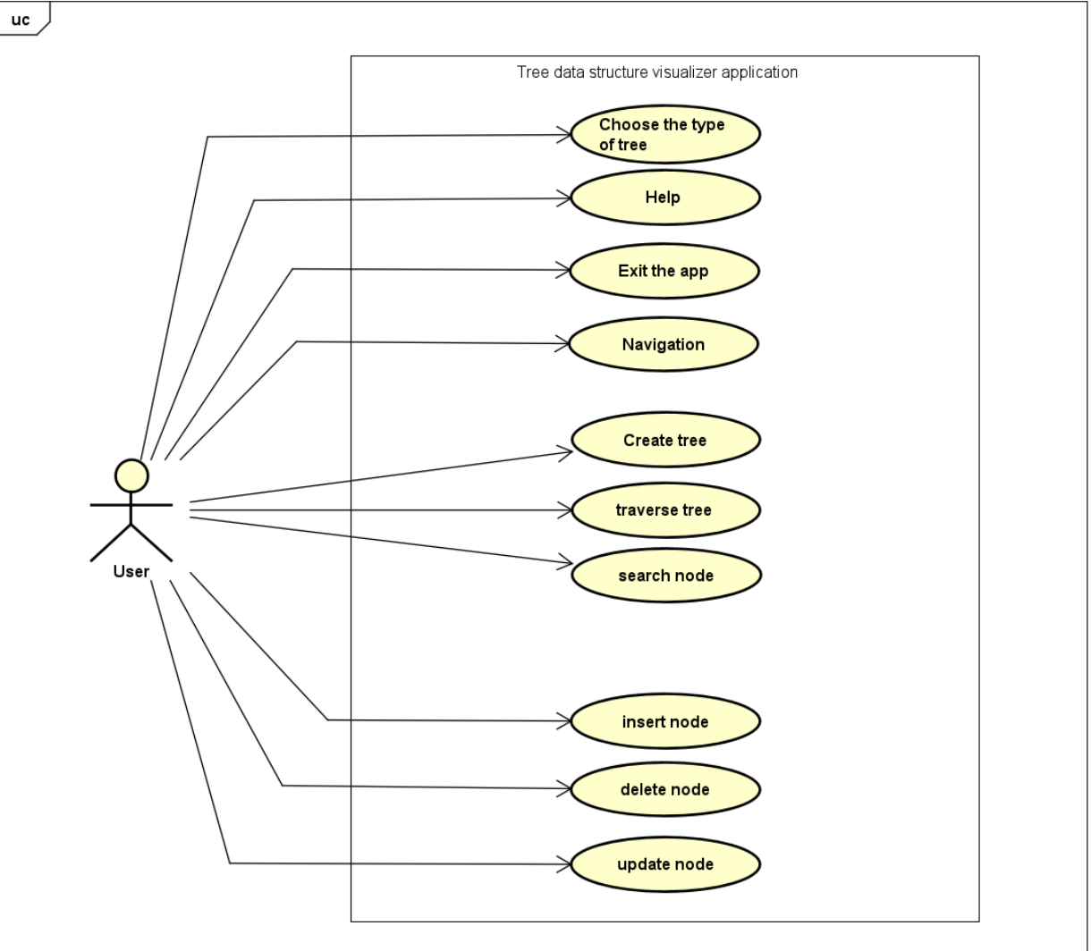
2. Use Case Diagram
user-friendly interface for choosing tree types and visualizing
user can perform essential tree operations
6

Slide 9
2. Use Case Diagram
"Help" button offers insights into the tree type being visualized
"Exit" button allows for easy program termination
6

Slide 10
3. Project Design
3.1. General Class Diagram
3.2. Detail Class Diagram
6

Slide 11
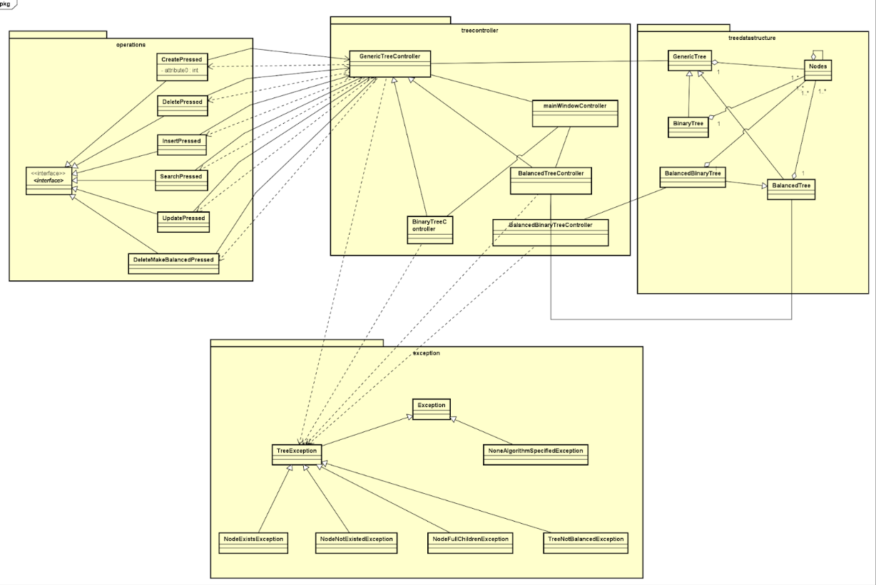
3.1. General Class Diagram
Four main packages:
Operation packages
Tree data structure package
Tree controller package
Exception package
6

Slide 12
3.2. Detail Class Diagram
3.2.1. Exception Class Diagram
3.2.2. Data Structure Class Diagram
3.2.3. Operation Class Diagram
3.2.4. Controller Class Diagram
6

Slide 13
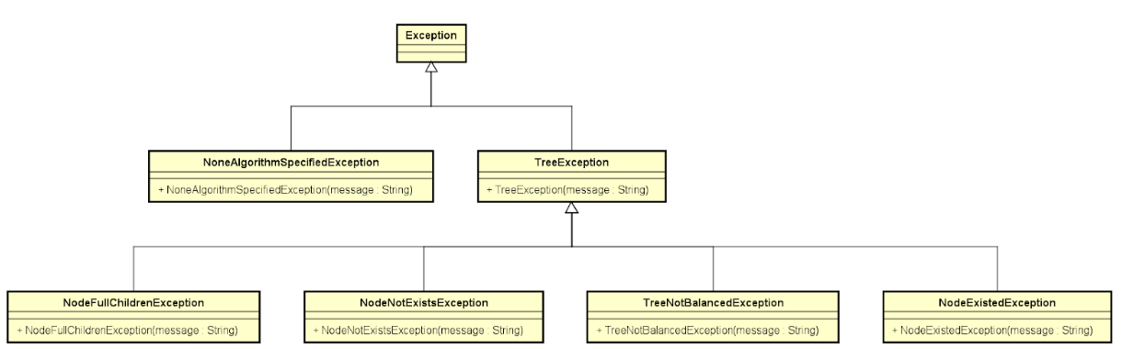
3.2.1. Exception Class Diagram
6

Slide 14
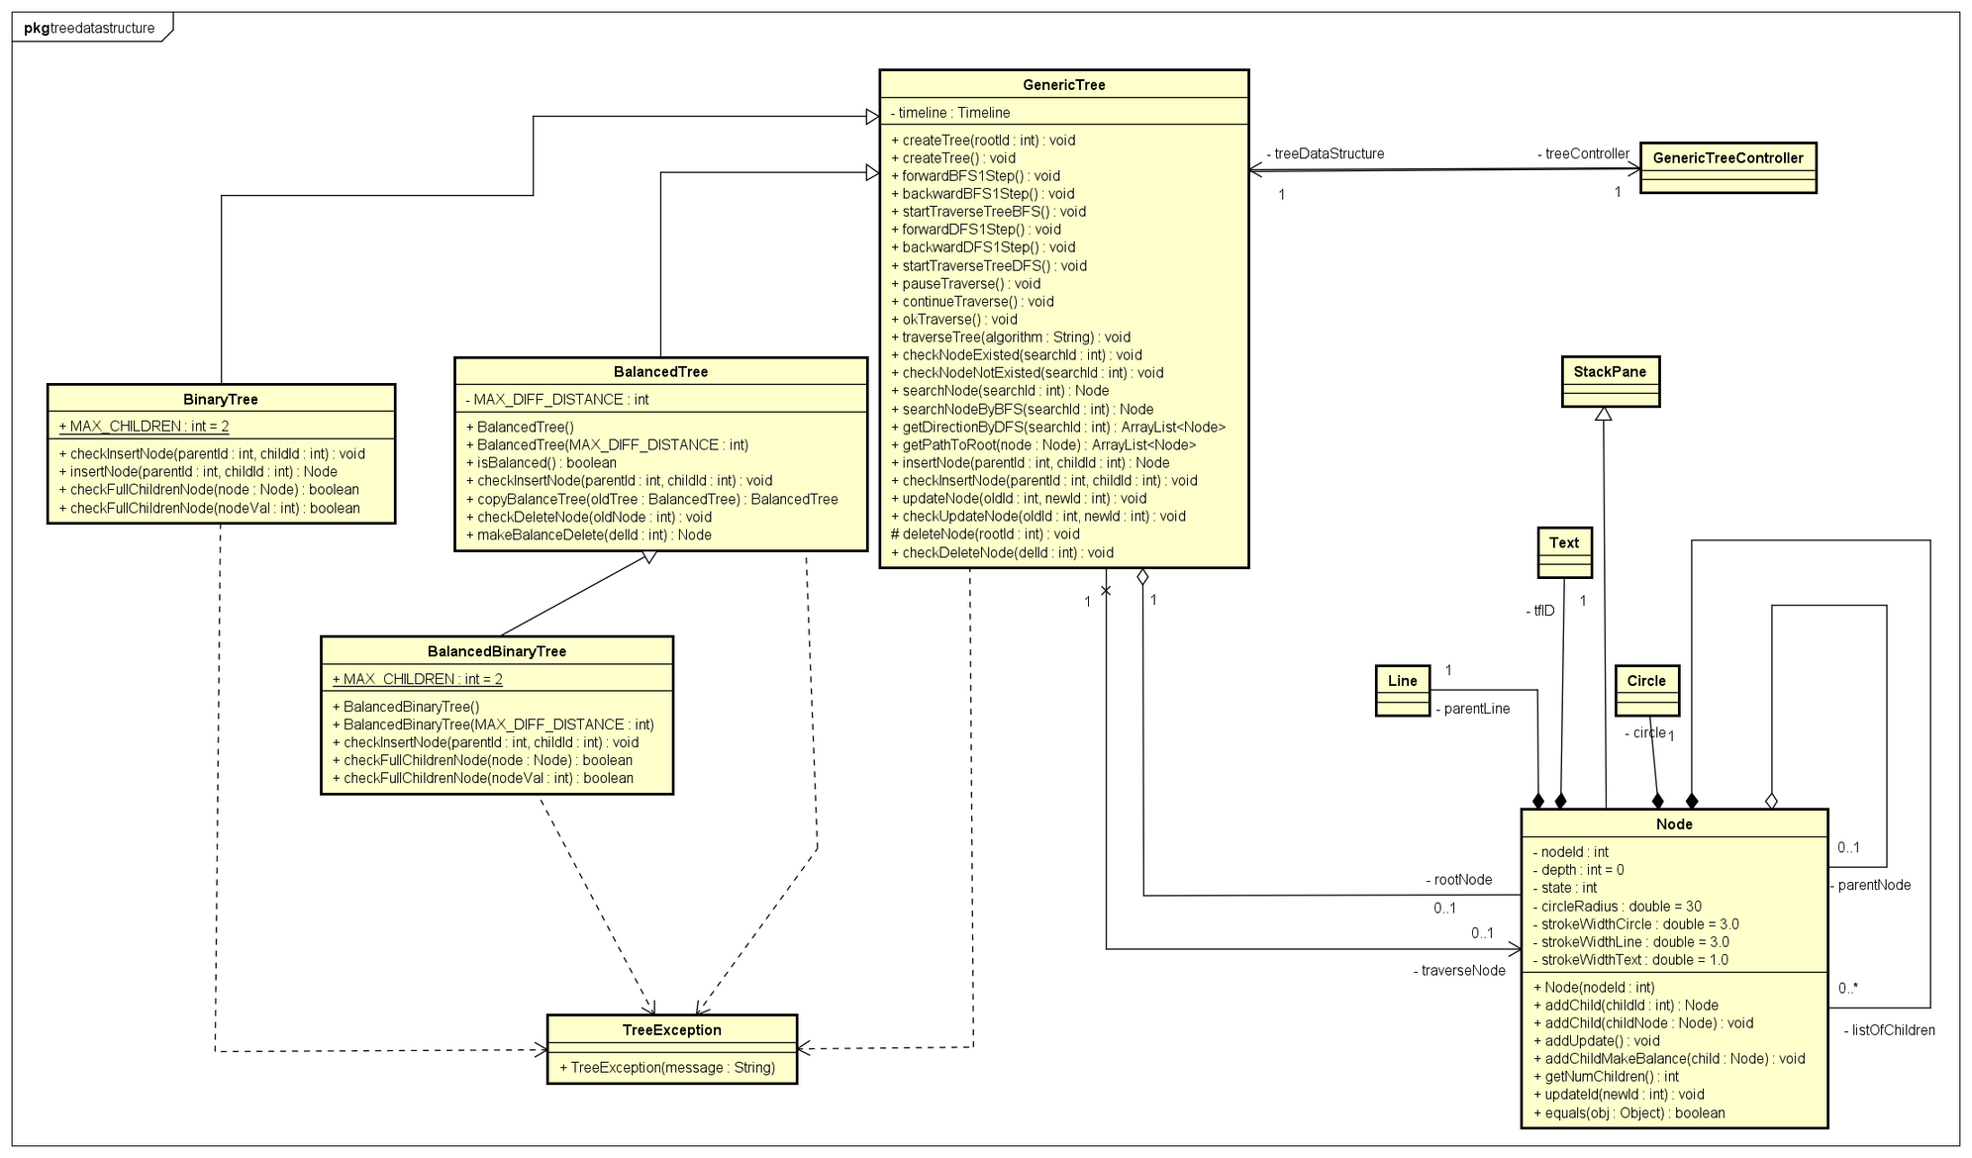
3.2.2. Tree Data Structure Class Diagram
6

Slide 15
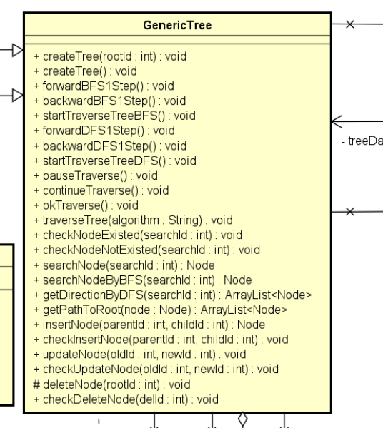
3.2.2. Tree Data Structure Class Diagram
Generic Tree class
A generic tree is a tree structure where each node can have an arbitrary number of children nodes.
Six operations are supported in the Generic Tree Class, including insert, delete, search, traverse, create, update.
6

Slide 16
3.2.2. Tree Data Structure Class Diagram
Generic Tree class
For each operation, corresponding exceptions are handled, ensuring robustness in the tree's manipulation.
The class also implements checking algorithms to validate the operations, ensuring the tree remains consistent.
6

Slide 17
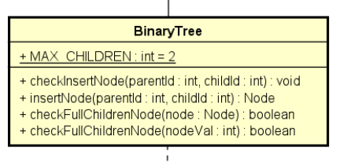
3.2.2. Tree Data Structure Class Diagram
Binary Tree class
The Binary Tree Class is a subclass of the Generic Tree Class with modifications to handle binary trees.
The insert operation is enhanced to check if a node can accept more children or raise NodeFullChildrenException.
Other operations are inherited from the Generic Tree Class, ensuring a unified interface for tree manipulation.
6

Slide 18
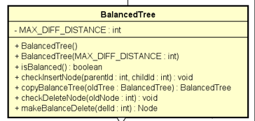
3.2.2. Tree Data Structure Class Diagram
Balanced Tree Class
The Balanced Tree Class represents a balanced tree data structure that maintains depth difference among leaf nodes, ensuring efficiency.
It inherits from the Generic Tree Class and adds two algorithms for insert and delete operations to maintain balance.
6

Slide 19
3.2.2. Tree Data Structure Class Diagram
Balanced Tree Class
If an invalid operation makes the tree unbalanced, the user can choose to undo or proceed with the operation.
When proceeding, our algorithms re-balance the tree, which may involve changing some nodes' parent nodes.
6

Slide 20
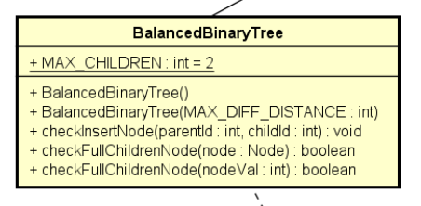
3.2.2. Tree Data Structure Class Diagram
Balanced Binary Tree Class
The Balanced Binary Tree Class is a subclass of the Balanced Tree Class, tailored for binary trees.
It introduces additional methods and logic to maintain the binary property during insertions.
The class ensures that the binary tree remains balanced and efficient while supporting all generic tree and balanced tree operations.
6

Slide 21
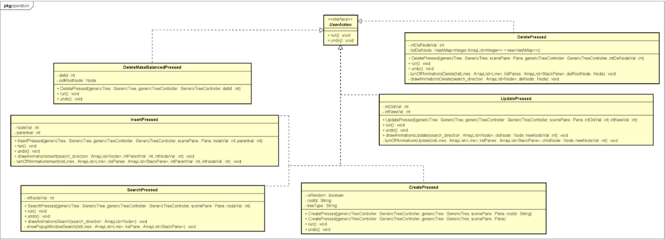
3.2.3. Operation Class Diagram
6

Slide 22
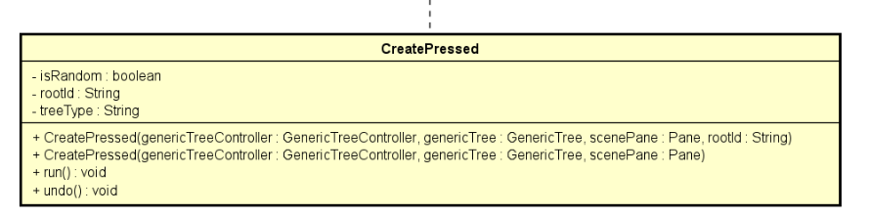
3.2.3. Operation Class Diagram
CreatePressed Class:
Attributes: isRandom (boolean), rootID (String)
run(): Creates a tree based on user's choice, either random or manual input.
undo(): Clears the tree by setting its root to null and removes it from the scenePane.
6

Slide 23
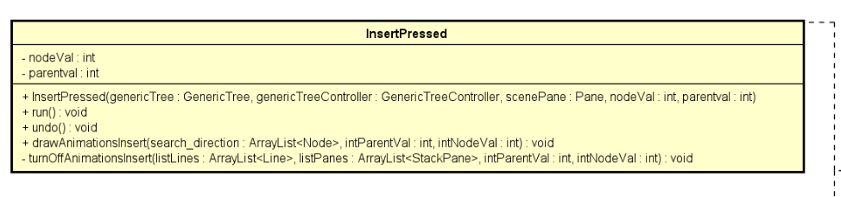
3.2.3. Operation Class Diagram
InsertPressed Class:
Attributes: parenVal (int), nodeVal (int), parent (Node)
run(): Inserts a node into the tree, highlighting the path from root to parent node.
undo(): Removes the child node from the tree and GUI to revert the insertion.
6

Slide 24
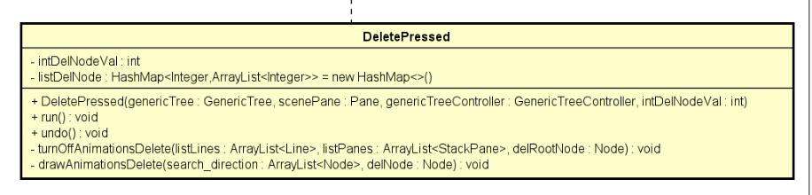
3.2.3. Operation Class Diagram
DeletePressed Class:
Attributes: intDelNodeVal (int), parentDelNode (Node), listDelNode (HashMap)
run(): Deletes a node from the tree, saving subtree information for undo.
undo(): Restores the deleted node and its subtree to the parent node.
6

Slide 25
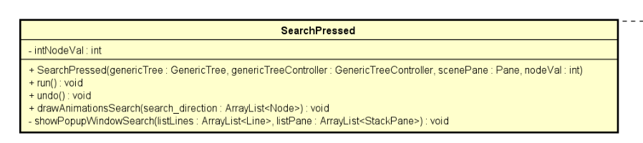
3.2.3. Operation Class Diagram
SearchPressed Class:
Attribute: intNodeVal (int)
run(): Searches for a node, highlighting the path from root to the search node.
undo(): No action required for undo since static operation
6

Slide 26
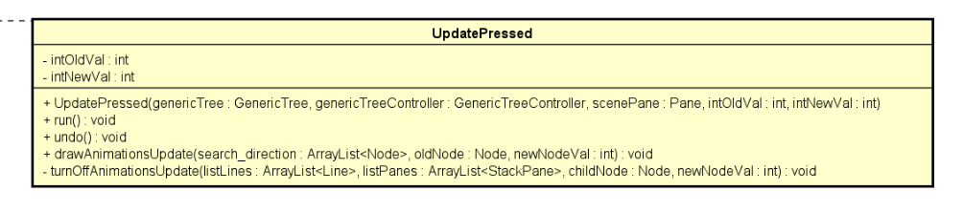
3.2.3. Operation Class Diagram
UpdatePressed Class:
Attributes: inOldVal (int), intNewVal (int)
run(): Updates a node's ID, highlighting the path from root to the node.
undo(): Reverts the node's ID to the old value.
6

Slide 27
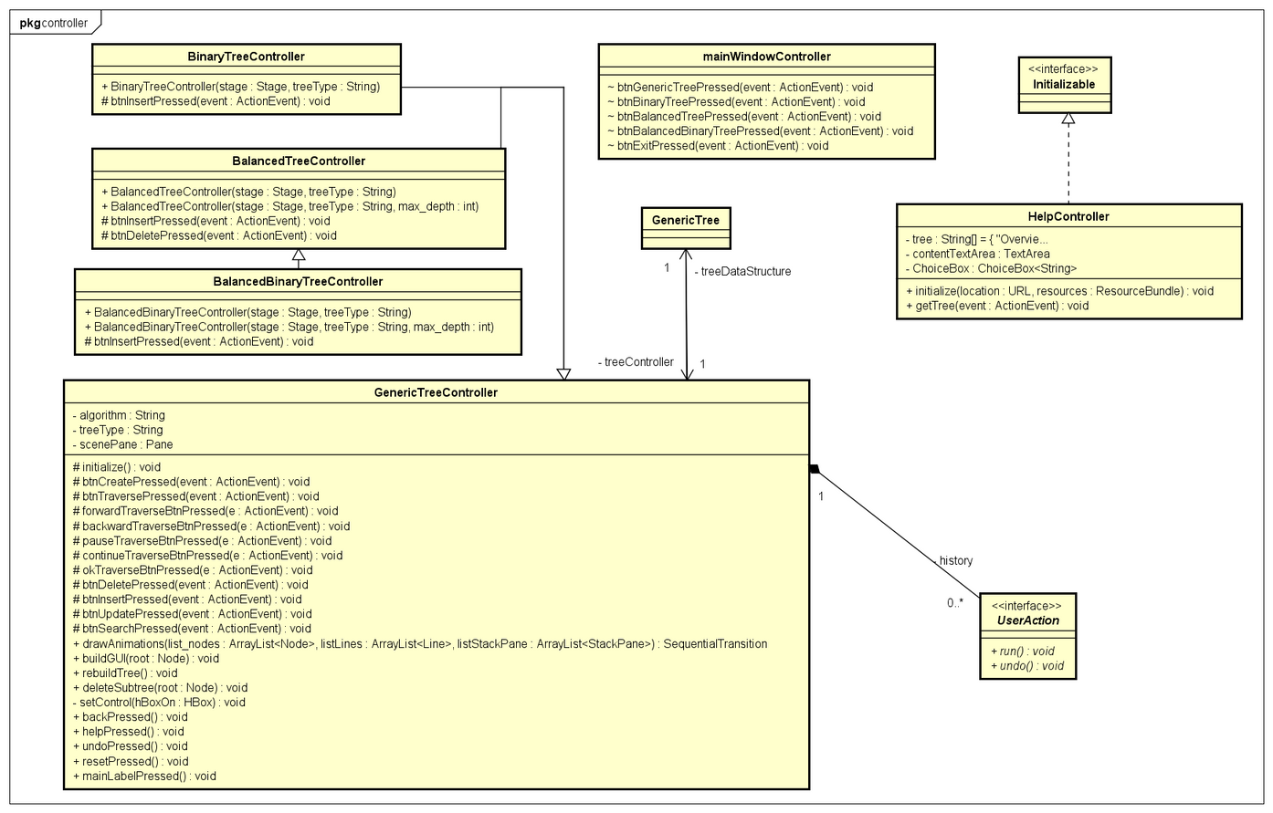
3.2.4. Controller Class Diagram
The package Controller contains 6 controllers:
MainWindowController
HelpController
GenericTreeController
BalancedTreeController
BinaryTreeController
BalancedBinaryTreeController
6

Slide 28
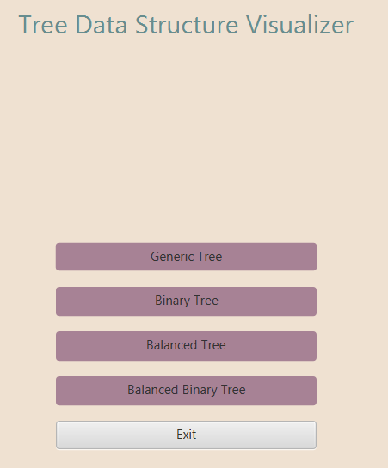
3.2.4. Controller Class Diagram
MainWindowController
6

Slide 29
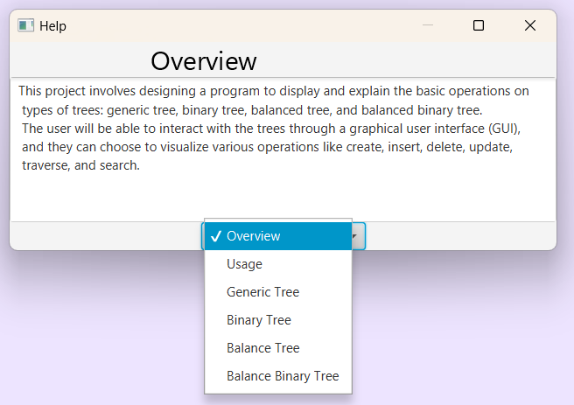
3.2.4. Controller Class Diagram
HelpController
6

Slide 30
3.2.4. Controller Class Diagram
GenericController
Has 3 main attributes.
Controls 6 basic operations:
Create
Search
Traverse
Insert
Delete
Update
and 4 other ones:
Back, Undo
Reset, Help
6

Slide 31
3.2.4. Controller Class Diagram
GenericTreeController
Except the Traverse, handle functions in the form:
Get the ID
Check the conditions
Create a Pressed object.
run()
Add the object to history
6

Slide 32
3.2.4. Controller Class Diagram
BalancedTreeController & BinaryTreeController
Inherit from GenericTreeController
Create
Traverse
Search
Update
BalancedTreeController overrides
Insert
Delete
BinaryTreeController overrides
Insert
6

Slide 33
3.2.4. Controller Class Diagram
BalancedBinaryTreeController
Inherits from BalancedTreeController.
Overrides the method Insert
6

Slide 34

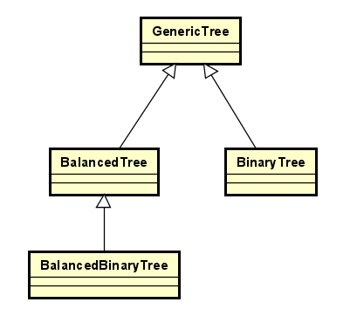
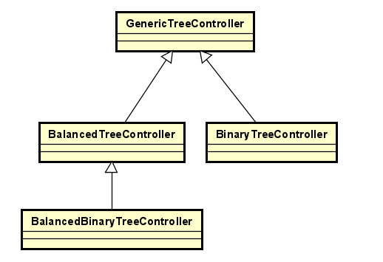
4. Explaination of OOP techniques
Inheritance
package treedatastructure
package controller
7

Slide 35
4. Explaination of OOP techniques
Encapsulation
We’ve used the Encapsulation technique in almost all classes to hide the internal state and implementation details from external entities.
For example, in class Node, we set ‘private’ for its attributes such as NodeId, depth, …
If other classes want to access the attributes, they can use getter and setter methods.
7

Slide 36
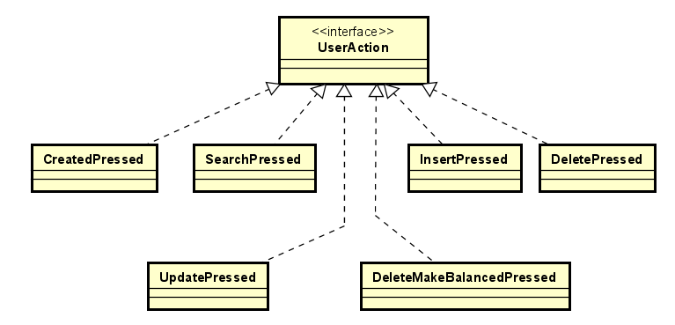
4. Explaination of OOP techniques
Polymorphism
Firstly, we have used the Polymorphism technique when implementing an “undo” operation.
package operation
7

Slide 37
4. Explaination of OOP techniques
Polymorphism
Secondly, we have used the technique when implementing each operation.
package treedatastructure
7

Slide 38
4. Explaination of OOP techniques
Association & Aggregation
GenericTreeController controls and manipulates the GenericTree.
The operation classes in package operation change the GenericTree and manipulate the tree-display Pane of GenericTreeController.
The Node has its parent which is also a Node and when the Node is deleted, its parent still exists.
In addition, this relationship is presented where the GenericTree has a root Node.
7

Slide 39
4. Explaination of OOP techniques
Composition
The Node contains three objects Circle, TextField, Line which are used to display the node on screen.
The Node has many children (which are stored in an attribute arraylist listOfChildren).
GenericTreeController has an array named history which contains many UserAction-implemented objects.
7

Slide 40
4. Explaination of OOP techniques
Dependency
The controller classes depend on the tree data structure classes.
The GenericTreeController class depends on the operation classes in package operation to perform the corresponding tree operations.
The main application class depends on the ‘controller’ package.
In the operations of four types of tree, we also use the Exceptions, so the Trees are dependent on the Exceptions.
7

Slide 41

DEMO
13

Slide 42
THANK YOU !
13

